Slide 1
Kerry Bruce
Integrating the Raspberry Pi into your CIS/CS Programs
2021 Winter ICT Educators Conference

Slide 2
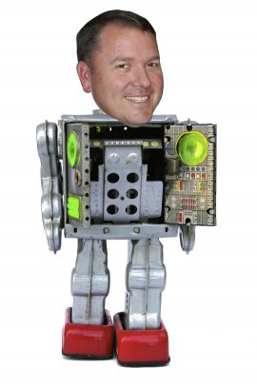
Welcome
Thank you for joining me for this presentation.
A Live Raspberry Pi Lab Follows…

Slide 3
Introduction
Kerry A. Bruce
20+ Years in IT Industry – Small Biz, State Gov, Citibank, Sandia National Labs, VAR Owner
8 Years – CIS Instructor – Central New Mexico Community College (Jefferson College)
4 Years – Cisco Instructor Trainer (IoT Fundamentals Courses) – WASTC
2019-2020 CNM-BIT Distinguished Faculty
Raspberry Pi Certified Educator (Have used the Raspberry Pi in the classroom since 2014)

Slide 4
Agenda
01.
03.
Why the Raspberry Pi?
Configurations
Why the Raspberry Pi may be a good fit for your students
Review of some common Raspberry Pi configurations and cost
02.
04.
Potential Uses…
Conclusion/Questions
Quick tour of potential projects, assignments, use cases for the Raspberry Pi
Let’s wrap it up and peek at all the cool resources listed on www.myitinstructor.com/WASTC

Slide 5
Key Takeaway…
What one assignment or project could I change to include a Raspberry Pi in order to enhance my student's engagement in the assignment or project?

Slide 6
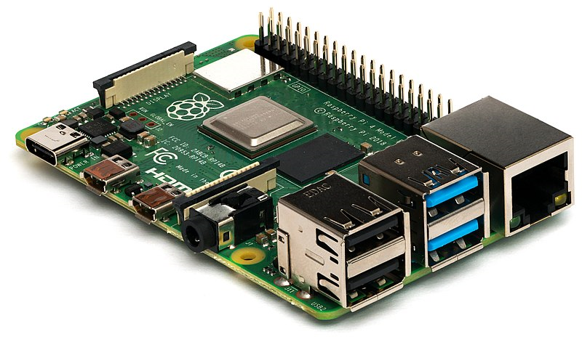
Why Integrate the Raspberry Pi into your CIS/CS Program…
Low Cost
Flexibility / Expandability / GPIOs
Power / Size
Community
Tactile Learning Opportunities

Slide 7
HTTPS://MyITInstructor.com/WASTC
This is a Resource Heavy Presentation…
I have listed all the links used to create this presentation plus many more on my website.
Please visit the website to dig into the ideas shared in this presentation.
Sign up for the newsletter to stay informed.
If you would like to contribute, please reach out to me at kerry@myitinstructor.com.

Slide 8
Examples and Use Cases

Slide 9
Raspberry Pi in Networking
Network+ Course – I have my students build the network infrastructure on Raspberry Pis.
DNS/DHCP/WAP/Firewall/Proxy/File(SMB/NFS)/Print/VPN/VOIP/Network Monitoring/Network Scanner/Ad Blocking/TOR/Captive Portal/Dynamic DNS and DOOM.
Used online ticketing system (Spiceworks) to assign work related to the network build to simulate the real world

Slide 10
Raspberry Pi in Programming
Languages
Python, Java, Node-RED, SQL,
PERL, Erlang, Scratch, Sonic-Pi, Wolfram, C, C++, C#, Rust, PHP, HTML5, JQuery, Node-js, PHP, LaTeX, Arduino, JavaScript, Fortran, Cobol, Go, R, Swift, Ruby, Scala, Kotlin
Flexibility - IDEs
IDLE, MU, Thonny, BlueJ, Geany, Greenfoot, Mathmatica, Wolfram Scratch, Blockly, Visual Studio Code, Node-RED, Node-js, Arduino, Adafruit WebIDE, AlgoIDE, Ninja, Lazarus, Codeblock, Jupyter Notebook, MATLAB
Physical Computing
The General-Purpose Input Output (GPIO) Pins provide for expansion, added capabilities and physical computing opportunities that are not available with a laptop or PC

Slide 11
Raspberry Pi in Cyber Security
Cisco IoT Fundamentals Security
Explore Device, Network, and Application vulnerabilities on IoT (Raspberry Pi) Devices
Conduct Vulnerability and Risk Assessments
Security Game utilizing Raspberry Pi
Kali Linux on Raspberry Pi
Network Scanning with Raspberry Pi
Pineapple Pi – Portable Hacking Station

Slide 12
Raspberry Pi in Cloud Computing
AWS IoT
Azure (Windows IoT)
GCP IoT
MongoDB
IFTTT
Twitter
Dweet.io
OwnCloud
Google AIY Voice/Vision
Media Server
Cloud4RPi
Hologram
Zapier
Mythic Beasts
Raspberry Pi Servers in the cloud
Docker
Home Assistant
Amazon Alexa
UpSwift

Slide 13
Raspberry Pi in Web Dev
Runs Linux…
LAMP Stack
Python Web Server
See Cloud Computing List (APIs)
RESTful
Full Stack Development
PHP
HTML5
WordPress

Slide 14
Raspberry Pi in IoT
Basic Electronics – Helps students to understand how computers work and that the connections are critical to a properly functioning system.
Python Programming - Students learn to write simple scripts to automate menial tasks.
Reinforce Sys Admin Skills – Flash SD cards,
network configuration, Linux, project planning and management, remote control VNC/SSH, encryption keys, teamwork, presentation skills, and connecting divergent systems.
Creativity - When students are exposed to and asked to create their own Raspberry Pi projects, they are forced to think beyond the instructions. This process builds better IT Technician.

Slide 15
Raspberry Pi in Computer Science
AI/Machine Learning
Google AIY
Coral AIY
Tensor Flow
OpenCV
Pi-Top/.NET/Microsoft Teams
Robotics
Pi-Wars
Dexter Industries
Pi-Top Robotics Kit
Various Robotic Kits
HomeBuilt Robots
Parallel Computing
Beowolf Cluster
MPI/Python-MontanaTech
LANL (750 Nodes)
BuckeyePi (128 Nodes)
SJSU Parallel Computing

Slide 16
Raspberry Pi in System Administration
Linux (Over 50 distros available)
Remote Administration
VNC
SSH
KVM
Servers (Anything you can build on Linux)
Network Configuration and Infrastructure
Network Monitoring
Virtualization
KVM
ESXi
Thinlinx
Minos
BerryTerminal
Kali Linux
System Updates & Package Management
WiFi/BlueTooth/Ethernet

Slide 17
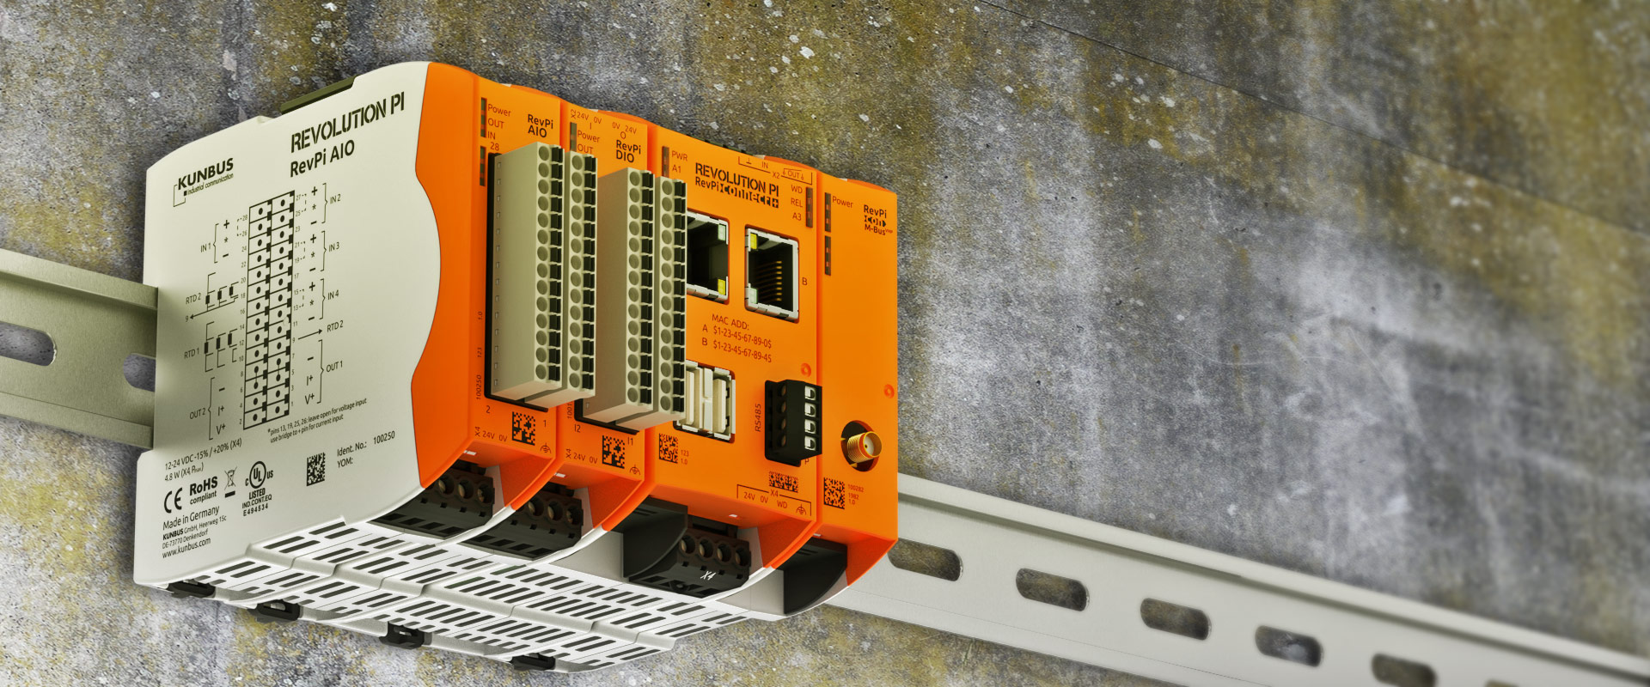
Industrial Uses of Raspberry Pi
MyPi - Industrial IoT Integrator Board
Revolution PI - OpenSource IPC based on Raspberry Pi
netPI – Industrial Raspberry Pi As Open Edge Connectivity Ecosystem
Raspberry Pi Compute Module

Slide 18
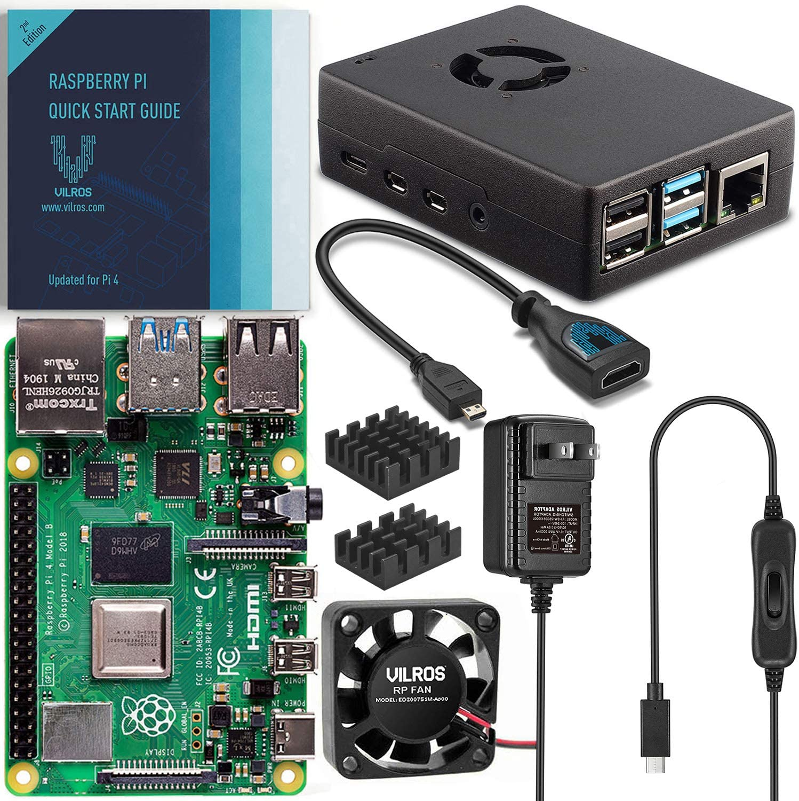
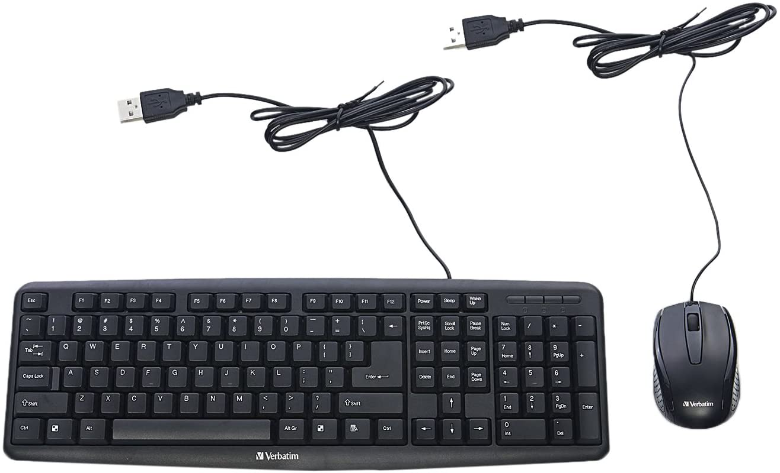
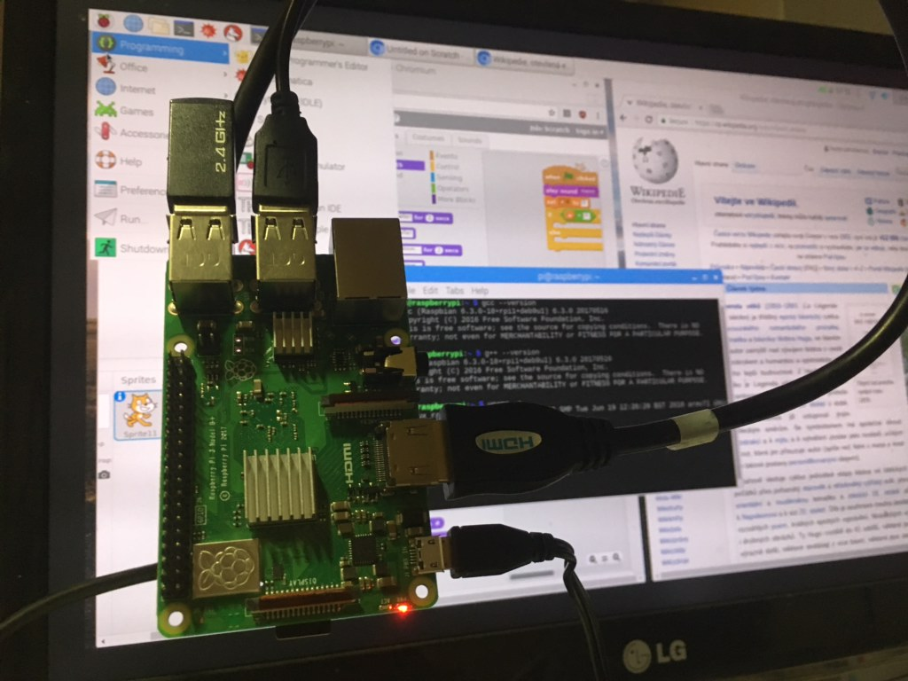
Raspberry Pi Basic Configuration
Basic Setup - $100 - $200 (up to $300 w/add-ons)
Raspberry Pi Kits from Vilros/Sparkfun/Raspberry Pi
Add used/spare Keyboard/Mouse/Monitor
Get extra SD cards for backups & different OSes.
Misc. HATs, physical computing components, etc.
Optional: Add Pi-Top[4] DIY Edition ($99.95)

Slide 19
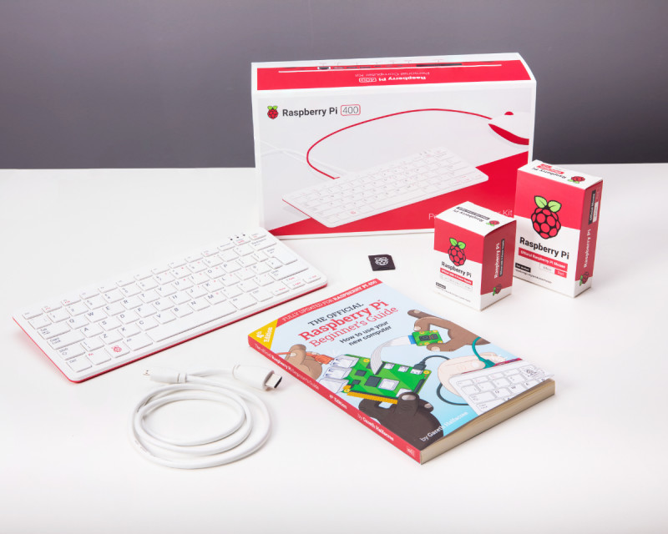
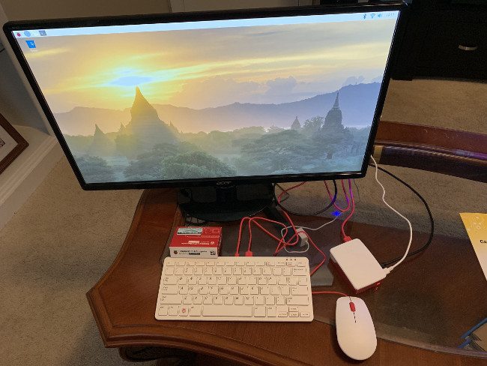
Raspberry Pi 400 Configuration
Raspberry Pi 400 Kit - $100 - $200 (up to $300 w/add-ons)
Raspberry Pi 400 Kits from Raspberry Pi
Add used/spare Monitor
Add a GPIO Expansion board for ease of use
Get extra SD cards for backups & different OSes.
Misc. HATs, physical computing components, etc.

Slide 20
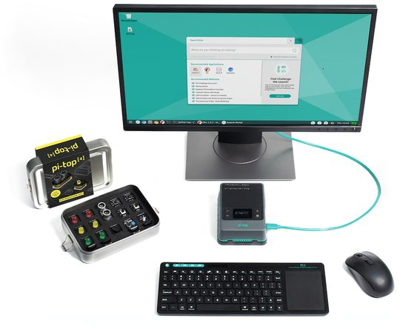
Pi-Top[4] Configuration
Pi-Top[4] Setup - $250 - $600
Pi-Top[4] Complete Kit
Add used/spare Keyboard/Mouse/Monitor
Get extra SD cards for backups & different OSes.
Misc. HATs, physical computing components, etc.
Optional: Add Pi-Top Keyboard, Screen, Sensors, Robotics Kit

Slide 21
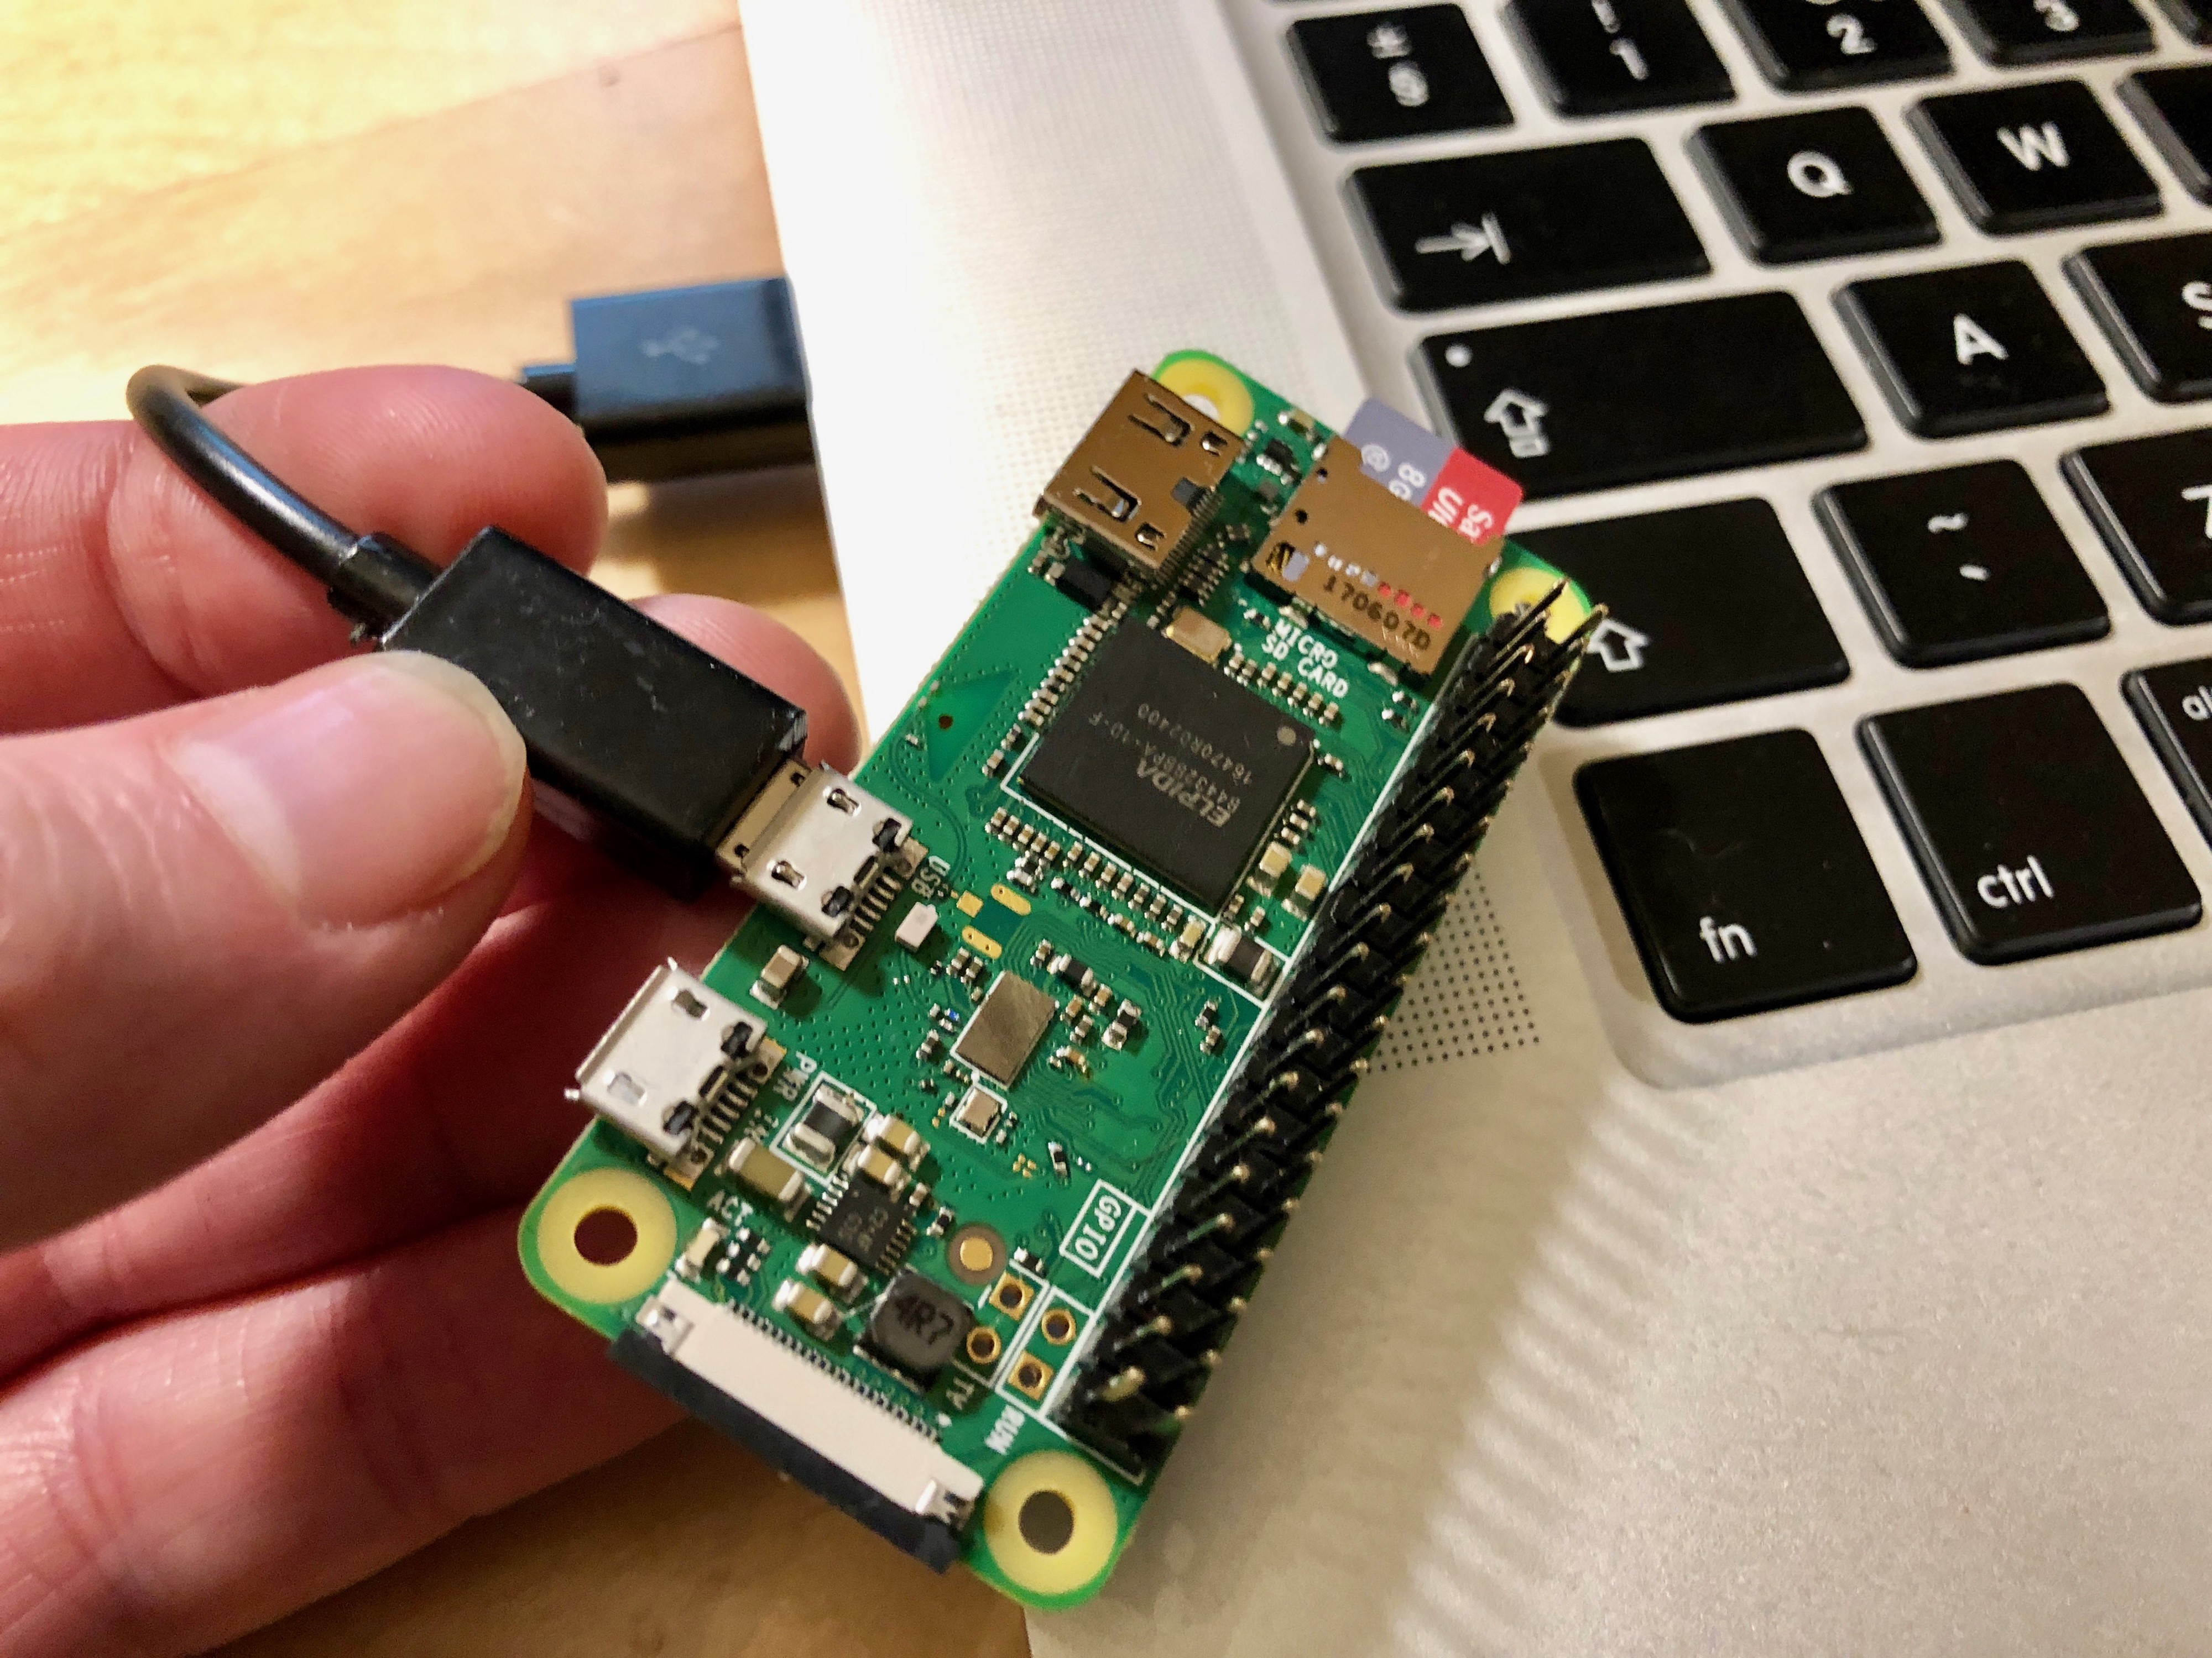
Raspberry Pi Desktop OS Config
Raspberry Pi Desktop OS w/PiZero- $100 - $200
Using Old desktop PCs/laptops install Raspberry Pi Desktop OS
Buy Raspberry PiZeroW Kit ($30)
Using a USB cable, you can interact with GPIOs on PiZero
Get extra SD cards for backups & different OSes.
Misc. HATs, physical computing components, etc.

Slide 22
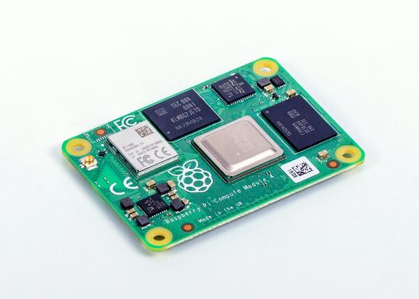
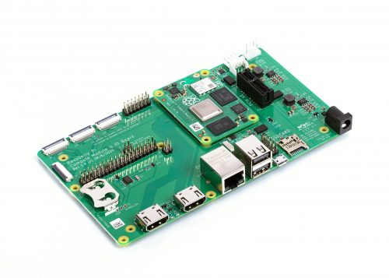
Compute Module 4 for Industrial IoT
Raspberry Pi Desktop OS w/PiZero- $100 - $200
Designed for Industrial or embedded applications.
Cost effective and powerful
32 versions of Compute Modules starting at $25 -$90
IO Board $35
Compute Module 4 Antenna Kit $6

Slide 23
Reasons for using Raspberry Pi in CIS/CS programs
Low Cost
Flexibility / Expandability / GPIOs
Power / Size
Community
Tactile Learning Opportunities
And they are just plain fun to work/play with…

Slide 24
Opportunities
Live Lab directly after this presentation…
WASTC Instructor Training
IoT Connecting Things (January 16^{th –} February 13^{th)} Now includes bonus hands-on labs hours.
IoT Big Data and Analytics (March 20th – April 17^{th)}
Post Covid-19 - Onsite/Remote Workshops for Instructors or Labs for Students
Conference Speaker/Workshop Facilitator
Web Page Resources – See https://myitinstructor.com for more information

Slide 25
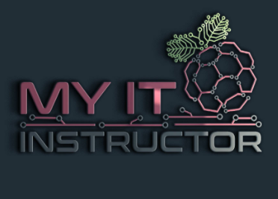
Contact Info: Kerry Bruce
Address
My IT Instructor
5901-J Suite 343
Albuquerque, NM 87109
Social Media
@MyITInstructor
E-mail
kerry@myitinstructor.com
Website
www.MyITInstructor.com

Slide 26
Thank you
Come join in on the Raspberry Pi Play Shop immediately following this presentation.
www.wastc.org

Slide 27
QUESTIONS?

