Slide 1
Welcome
Kerry Bruce
Central New Mexico Community College
Integrating the Raspberry Pi
into your CIS Programs

Slide 2
"I have been impressed with the urgency of doing. Knowing is not enough; we must apply. Being willing is not enough; we must do.“ Leonardo da Vinci

Slide 3
Key Takeaway…
What one assignment or project could I change to include a Raspberry Pi in order to enhance my student's engagement in the assignment or project?

Slide 4
Agenda
01.
Why the Raspberry Pi?
03.
Configurations
Why the Raspberry Pi may be a good fit for your students
Review of some common Raspberry Pi configurations and cost
02.
Potential Uses…
04.
Conclusion/Questions
Quick tour of potential projects, assignments, use cases for the Raspberry Pi
Let’s wrap it up and peek at all the cool resources listed on http://www.myitinstructor.com/nctc.html

Slide 5
http://www.myitinstructor.com/nctc.html
Resources
This is a Resource Heavy Presentation…
I have listed all the links used to create this presentation plus many more on my website.
Please visit the website to dig into the ideas shared in this presentation.

Slide 6
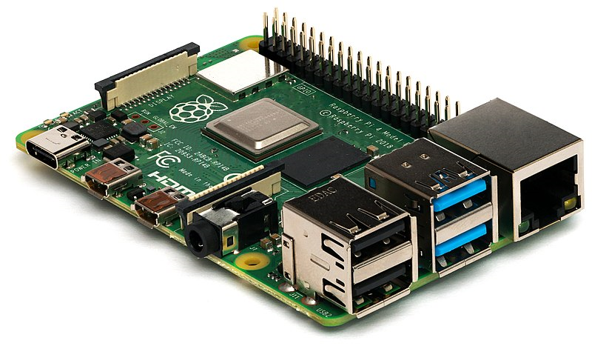
Why Integrate the Raspberry Pi into your CIS/CS Program…
Low Cost
Flexibility / Expandability / GPIOs
Power / Size
Community
Tactile Learning Opportunities

Slide 7
Examples and Use Cases

Slide 8
Raspberry Pi in System Administration
Linux (Over 50 distros available)
Remote Administration
VNC
SSH
KVM
Servers (Anything you can build on Linux)
Network Configuration and Infrastructure
Network Monitoring
OS Image Flashing
Virtualization
KVM
ESXi
Thinlinx
Minos
BerryTerminal
Kali Linux
System Updates & Package Management
WiFi/BlueTooth/Ethernet

Slide 9
Raspberry Pi in Networking
Network+ Course – I have my students build the network infrastructure on Raspberry PIs.
DNS/DHCP/WAP/Firewall/Proxy/File(SMB/NFS)/Print/VPN/VOIP/Network Monitoring/Network Scanner/Ad Blocking/TOR/Captive Portal/Dynamic DNS / NAS.
Used online ticketing system (Spiceworks) to assign work related to the network build to simulate the real world
Optional: Pi(Rate) Box, OwnCloud, and Quake/DOOM/Minecraft.

Slide 10
Raspberry Pi in Cloud Computing
AWS IoT
Azure (Windows IoT)
GCP IoT
MongoDB
IFTTT
Twitter
Dweet.io
OwnCloud
Google AIY Voice/Vision
Media Server
Cloud4RPi
Hologram.io
Zapier
Initial State
Mythic Beasts
Raspberry Pi Servers in the cloud
Docker
Home Assistant
Amazon Alexa
UpSwift.io

Slide 11
Raspberry Pi in Cyber Security
Cisco IoT Fundamentals Security Course
Explore Device, Network, and Application vulnerabilities on IoT (Raspberry Pi) Devices
Conduct Vulnerability and Risk Assessments
Security Game utilizing Raspberry Pi
Kali Linux on Raspberry Pi
Network Scanning with Raspberry Pi
Pineapple Pi – Portable Hacking Station

Slide 12
Raspberry Pi in Programming
Languages
Python, Java, Node-RED, SQL,
PERL, Erlang, Scratch, Sonic-Pi, Wolfram, C, C++, C#, Rust, PHP, HTML5, JQuery, Node-js, PHP, LaTeX, Arduino, JavaScript, Fortran, Cobol, Go, R, Swift, Ruby, Scala, Kotlin
Flexibility - IDEs
IDLE, MU, Thonny, BlueJ, Geany, Greenfoot, Mathmatica, Wolfram Scratch, Blockly, Visual Studio Code, Node-RED, Node-js, Arduino, Adafruit WebIDE, AlgoIDE, Ninja, Lazarus, Codeblock, Jupyter Notebook, MATLAB
Physical Computing
The General-Purpose Input Output (GPIO) Pins provide for expansion, added capabilities and physical computing opportunities that are not available with a laptop or PC

Slide 13
Raspberry Pi in AI/Machine Learning
AI/Machine Learning
Google AIY
Coral AIY
Tensor Flow
OpenCV
Pi-Top/.NET/Microsoft Teams
Robotics
Pi-Wars
Dexter Industries
Pi-Top Robotics Kit
Various Robotic Kits
HomeBuilt Robots

Slide 14
Raspberry Pi in IoT
Basic Electronics – Helps students to understand how computers work and that the connections are critical to a properly functioning system.
Python Programming - Students learn to write simple scripts to automate menial tasks.
Reinforce Sys Admin Skills – Flash SD cards, network configuration, Linux, project planning and management, remote control VNC/SSH, encryption keys, teamwork, presentation skills, and connecting divergent systems.
Creativity - When students are exposed to and asked to create their own Raspberry Pi projects, they are forced to think beyond the instructions. This process builds better IT Technician.

Slide 15
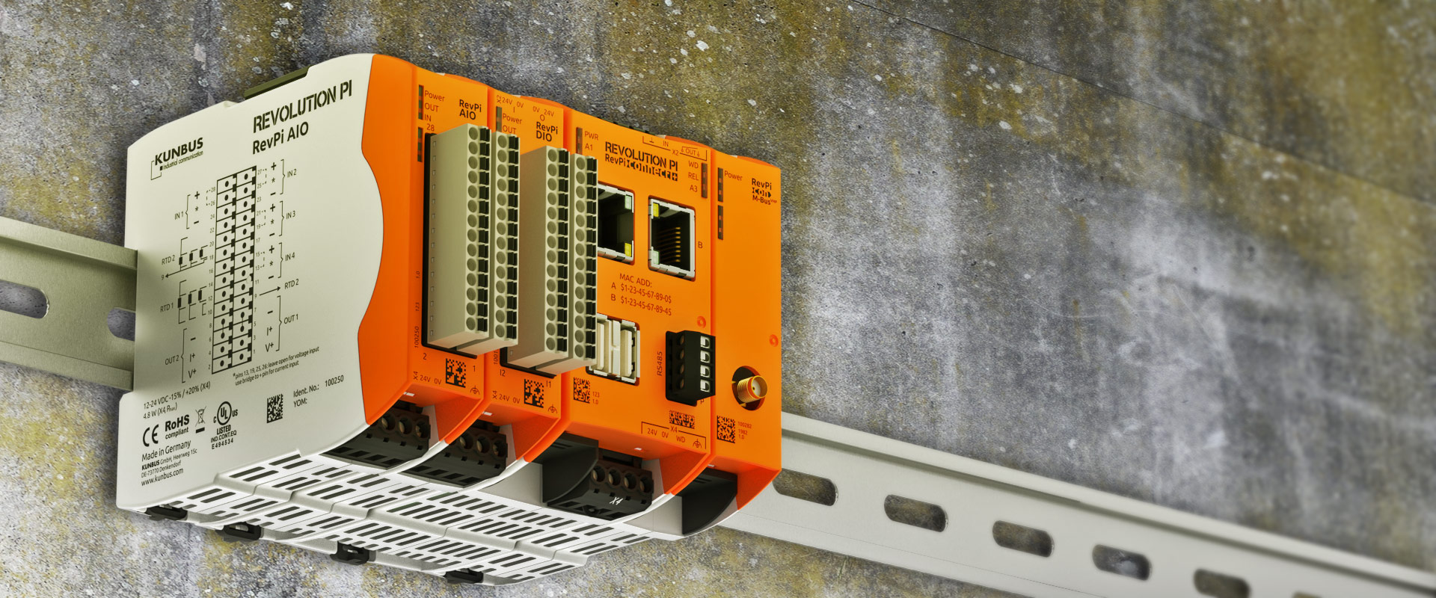
Industrial Uses of Raspberry Pi
MyPi - Industrial IoT Integrator Board
Revolution PI - OpenSource IPC based on Raspberry Pi
netPI – Industrial Raspberry Pi As Open Edge Connectivity Ecosystem
Raspberry Pi Compute Module

Slide 16
Just a Reminder… Why use Raspberry PIs in your CIS programs
Low Cost
Flexibility / Expandability / GPIOs
Power / Size
Community
Tactile Learning Opportunities
And they are just plain fun to work/play with…

Slide 17
Did you see something Interesting today? Can you think of at least one assignment or project could I change to include a Raspberry Pi in order to enhance my student's engagement in an assignment, topic or concept?

Slide 18
Opportunities…
WASTC Instructor Training - https://www.wastc.org/
Virtual Faculty Development Weeks (4.5-day Workshops) – https://www.wastc.org/2021-fdw
June 7 – 11, 2021 – Networking with the Raspberry Pi
June 14 – 18, 2021 – Teaching CIS with the Raspberry Pi
Cisco IoT Connecting Things (Jul 10^{th –} Aug 7th, 2021⁾ Now includes bonus hands-on labs hours.
Cisco IoT Security (Nov 6th – Dec 11th, 2021) Now includes bonus hands-on Lab Hours
Cisco IoT Big Data and Analytics (March 20th – April 17th, 2022⁾
Post Covid-19 - Onsite/Remote Workshops for Instructors or Labs for Students
Conference Speaker/Workshop Facilitator

Slide 19
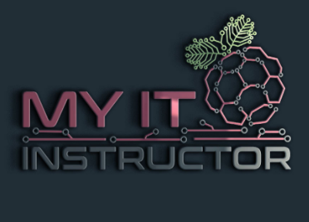
Contact Info: Kerry Bruce
Address
My IT Instructor
5901-J Suite 343
Albuquerque, NM 87109
Social Media
@MyITInstructor
E-mail
kerry@myitinstructor.com
Website
https://www.MyITInstructor.com

Slide 20
Thank you!
QUESTIONS?
www.wastc.org

Slide 21
About Me: Kerry A. Bruce
CompTIA ITF+, A+, Network+, Security+, Server+, Cloud+, AWS Cloud Practitioner, CCENT
2019-2020 CNM-BIT Distinguished Faculty
20+ Years in IT Industry – Small Biz, State Gov, Citibank, Sandia National Labs, MSP/VAR Owner
8+ Years – CIS Instructor – Central New Mexico Community College & Jefferson College
4+ Years – Cisco Instructor Trainer (IoT Fundamentals Courses) – WASTC
Raspberry Pi Certified Educator (Have used the Raspberry Pi in the classroom since 2014)

Slide 22
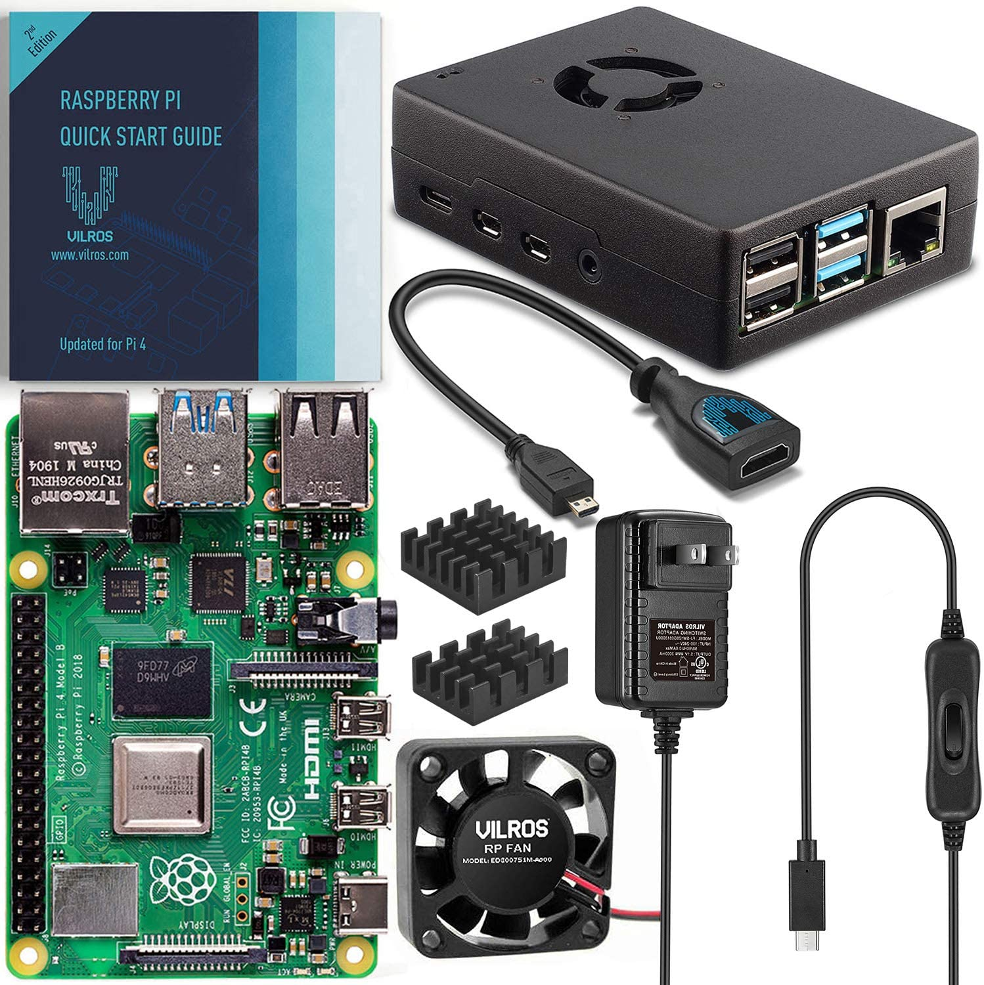
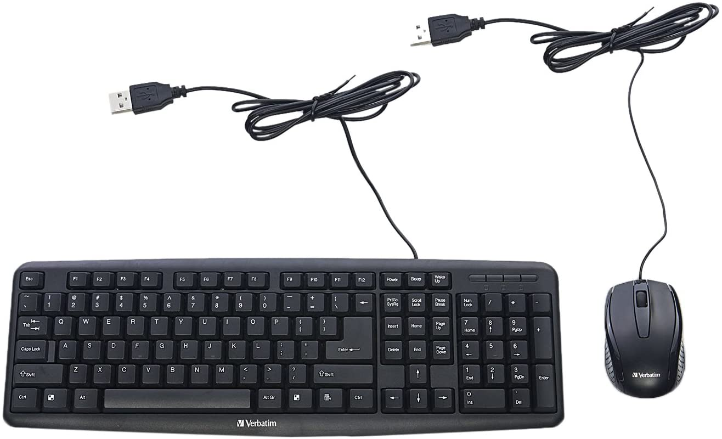
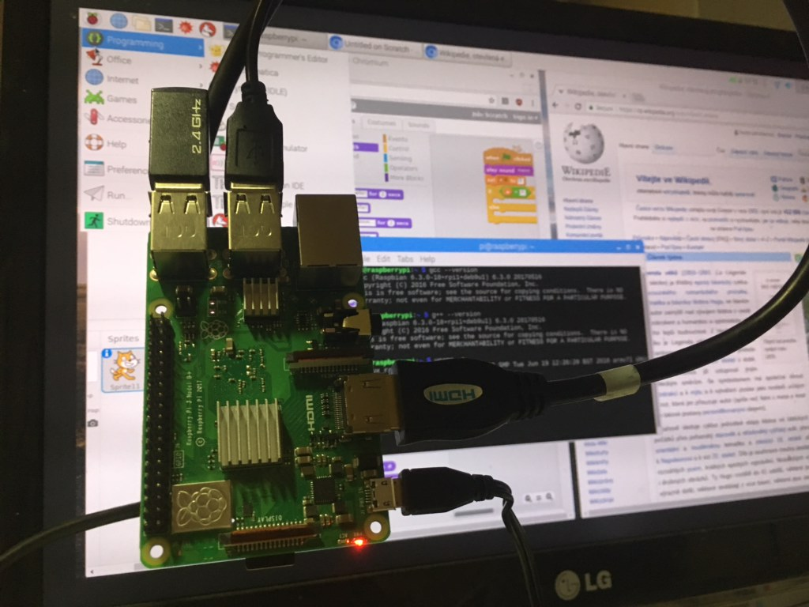
Raspberry Pi Basic Configuration
Basic Setup - $100 - $200 (up to $300 w/add-ons)
Raspberry Pi Kits from Vilros/Sparkfun/Raspberry Pi
Add used/spare Keyboard/Mouse/Monitor
Get extra SD cards for backups & different OSes.
Misc. HATs, physical computing components, etc.
Optional: Add Pi-Top[4] DIY Edition ($99.95)

Slide 23
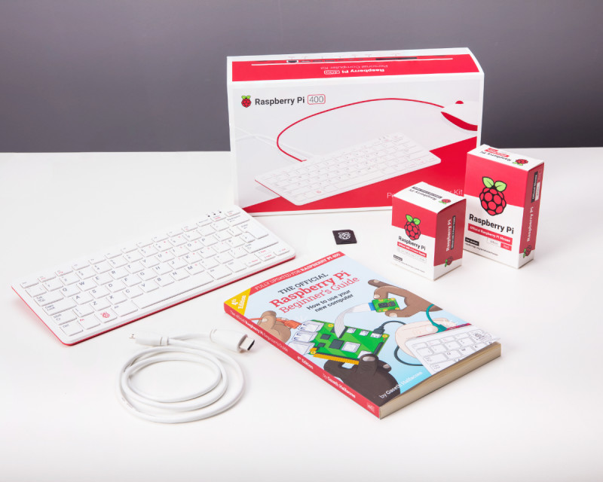
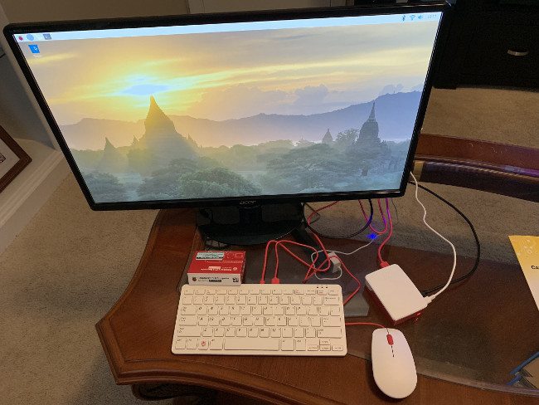
Raspberry Pi 400 Configuration
Raspberry Pi 400 Kit - $100 - $200 (up to $300 w/add-ons)
Raspberry Pi 400 Kits from Raspberry Pi
Add used/spare Monitor
Add a GPIO Expansion board for ease of use
Get extra SD cards for backups & different OSes.
Misc. HATs, physical computing components, etc.

Slide 24
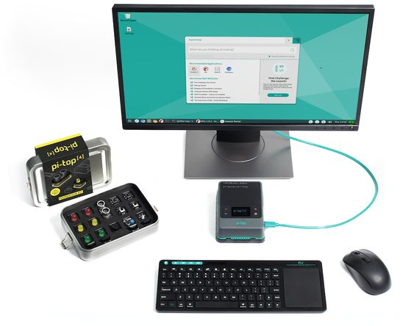
Pi-Top[4] Configuration
Pi-Top[4] Setup - $250 - $600
Pi-Top[4] Complete Kit
Add used/spare Keyboard/Mouse/Monitor
Get extra SD cards for backups & different OSes.
Misc. HATs, physical computing components, etc.
Optional: Add Pi-Top Keyboard, Screen, Sensors, Robotics Kit

Slide 25
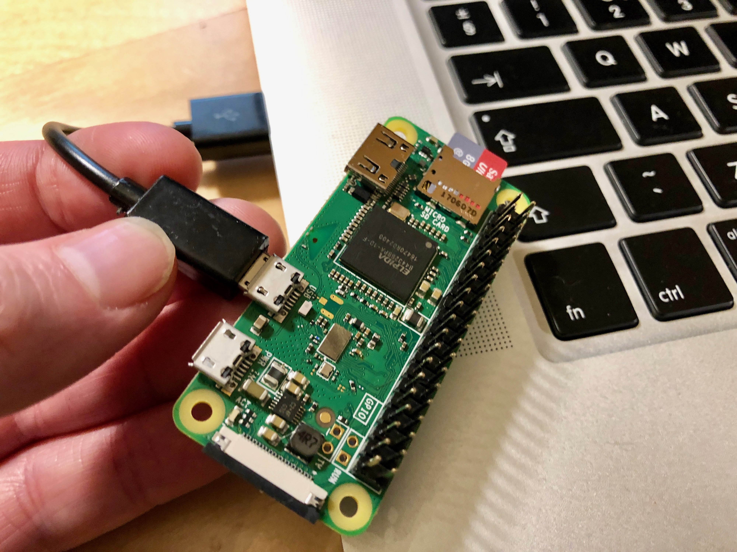
Raspberry Pi Desktop OS Config
Raspberry Pi Desktop OS w/PiZero- $100 - $200
Using Old desktop PCs/laptops install Raspberry Pi Desktop OS
Buy Raspberry PiZeroW Kit ($30)
Using a USB cable, you can interact with GPIOs on PiZero
Get extra SD cards for backups & different OSes.
Misc. HATs, physical computing components, etc.

Slide 26
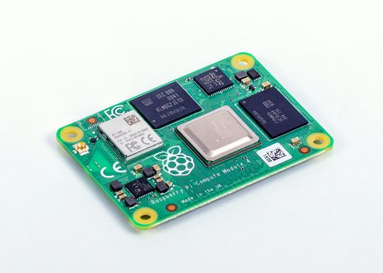
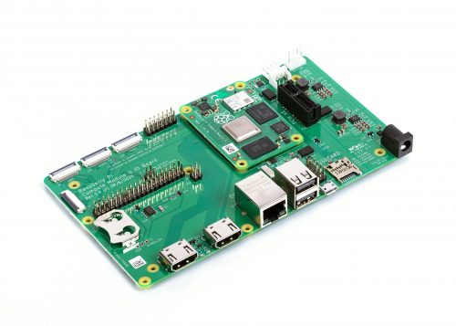
Compute Module 4 for Industrial IoT
Raspberry Pi Desktop OS w/PiZero- $100 - $200
Designed for Industrial or embedded applications.
Cost effective and powerful
32 versions of Compute Modules starting at $25 -$90
IO Board $35
Compute Module 4 Antenna Kit $6

